Slide 1


GRADE 8 ICT/DESIGN
Lesson 2: Reflect: Feedback and Design Rationale
Ms. Abboud • Grade 8 - ICT/Design • Term 1, Week 5

Slide 2
Learning Objectives
WALT - We Are Learning To
WILF - What I'm Looking For
Give and receive specific feedback on prototypes.
Explain a design change with evidence.
I gave specific, useful feedback to at least 2 other groups.
My design rationale explains a change and why, linked to a user need.

Slide 3
Academic Vocabulary
Feedback
Design Rationale
Specific, useful comments from someone else about how well something is working.
The reasons behind a design decision: explaining WHY you made a choice, not just what you made.

Slide 4
Frayer Model: Feedback
DEFINITION
CHARACTERISTICS
Specific, useful comments from someone else about how well something is working.
Specific; about how something works; from someone else.
FEEDBACK
EXAMPLES
NON-EXAMPLES
"This button is hard to find because it's the same color as the background."
A vague comment like "looks cool."

Slide 5
National Identity Integration
UAE values of tolerance and respect: giving feedback kindly, and listening openly to other points of view even when they differ from our own.

Slide 6
STARTER
30-Second Share
Show your prototype to the person next to you for 30 seconds.
What's the first question they ask?
Hook • Engage & Ask
5 - 10 minutes

Slide 7
LESSON CORE
I Do: Specific vs. Vague
Stems: "I noticed..." "Have you considered...?" "What would happen if...?"
Specific: "The pocket is hard to reach because it's on the back."
Vague: "Looks cool."
Gradual Release of Responsibility
35 - 45 minutes
1 / 3

Slide 8
LESSON CORE
We Do: Design Charrette
Rotate to 2-3 other groups' prototypes.
Leave feedback on each: What works? What's unclear? What would you change?
Gradual Release of Responsibility
35 - 45 minutes
2 / 3

Slide 9
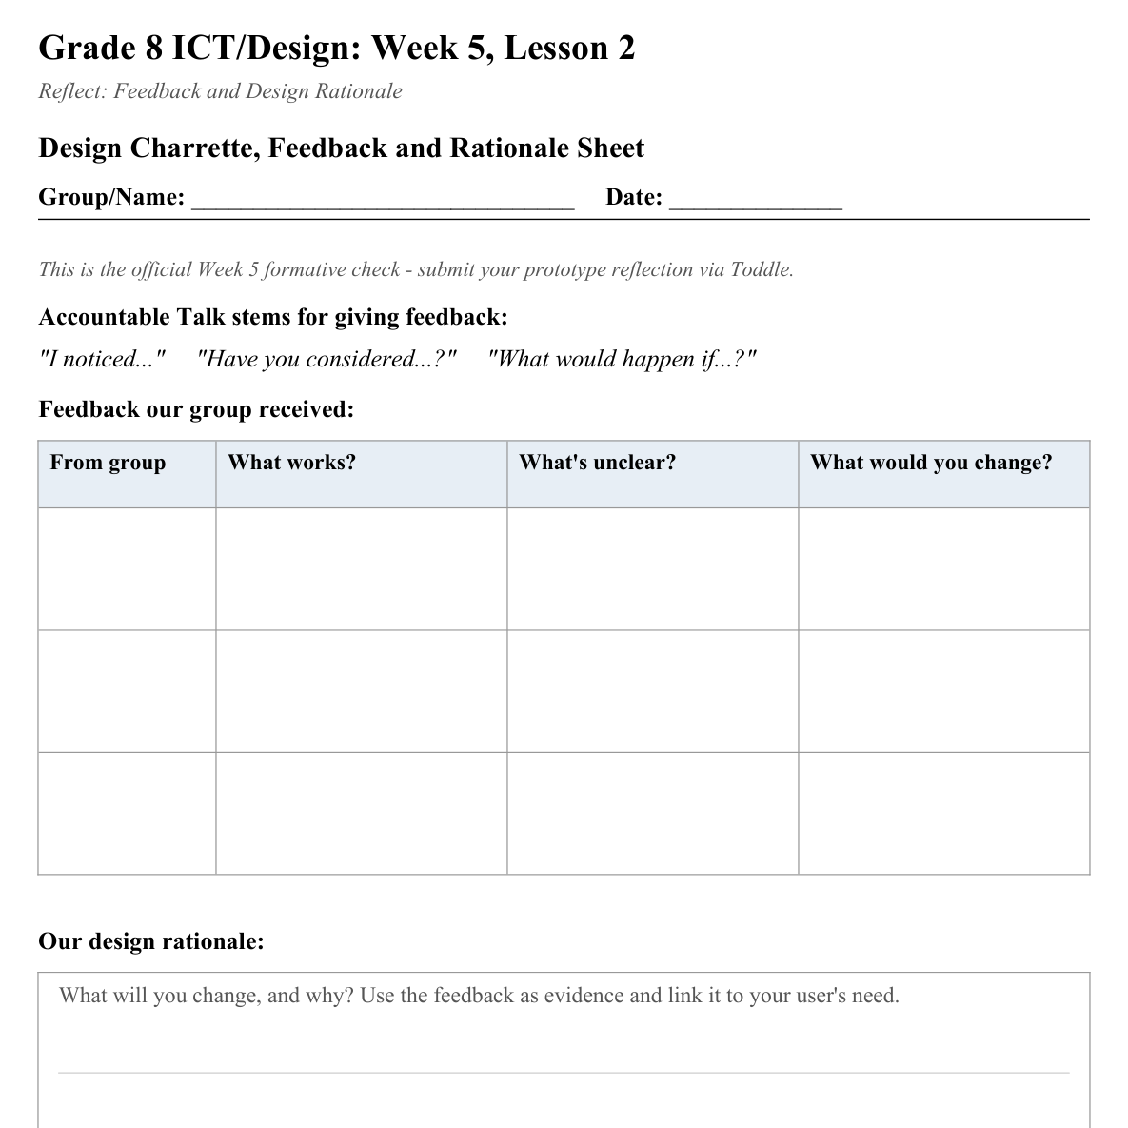
LESSON CORE
You Do: Design Rationale
Read the feedback you received.
Write your design rationale: one change you'll make, and why, linked to your user's need.
Activity: Design Charrette, Feedback and Rationale Sheet
Gradual Release of Responsibility
35 - 45 minutes
3 / 3

Slide 10
CLOSURE
Formal Check
Formal Week 5 formative check: submit your prototype reflection via Toddle.
Transition & Extend
5 - 10 minutes

